Slide 1


实验结果
数据集 | 准确度
SVAMP | 82.5%
Math Word Problem Solving by Generating Linguistic Variants of Problem Statements
Learning to Reason Deductively: Math Word Problem Solving as Complex Relation Extraction
SWIFTSAGE: A Generative Agent with Fast and Slow Thinking for Complex Interactive Tasks
Measuring and Narrowing the Compositionality Gap in Language Models

Slide 2
错误case 的解决1
Math Word Problem Solving by Generating Linguistic Variants of Problem Statements
Learning to Reason Deductively: Math Word Problem Solving as Complex Relation Extraction
28 children were riding on the bus. At the bus stop 82 children got on the bus while some got off the bus. Then there were 30 children altogether on the bus. How many more children got on the bus than those that got off?
we perturb the second sentence to make it semantically more straightforward

Slide 3
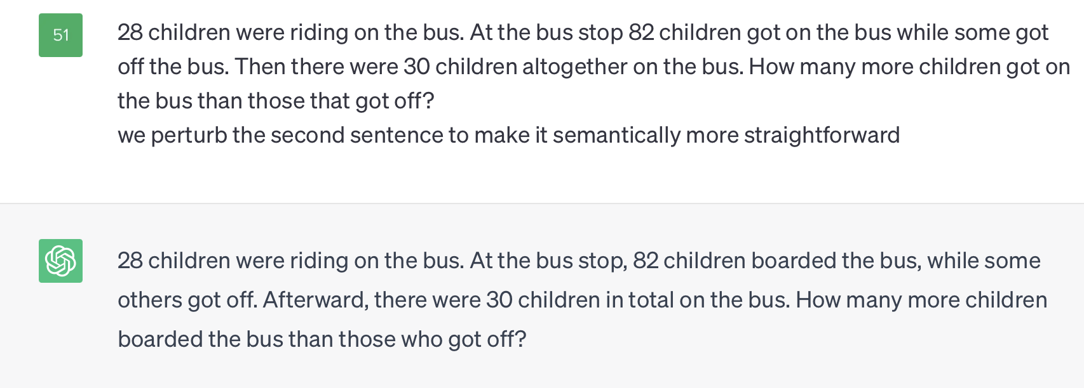
错误case 的解决1
28 children were riding on the bus. At the bus stop 82 children got on the bus while some got off the bus. Then there were 30 children altogether on the bus. How many more children got on the bus than those that got off?
we perturb the second sentence to make it semantically more straightforward

Slide 4
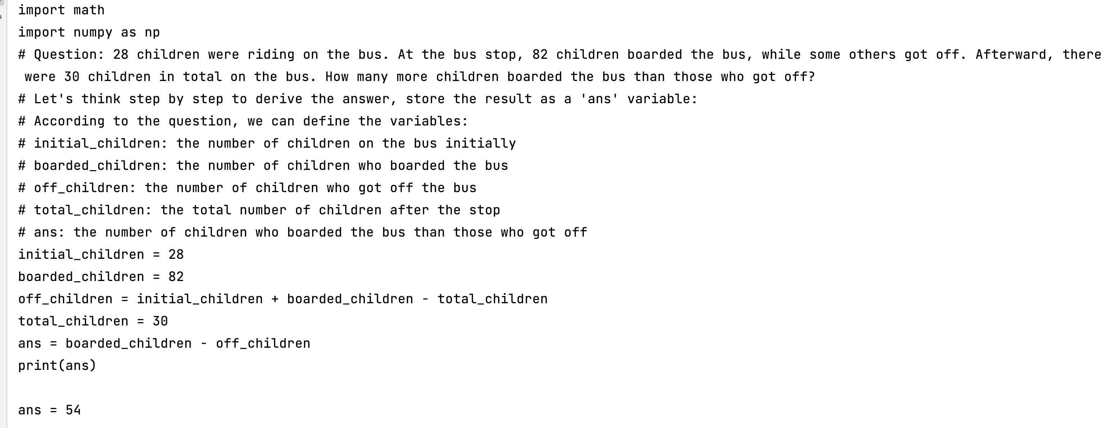
错误case 的解决1
Text-davinci-003推理的过程没有问题 BertSim/chatgpt0

Slide 5
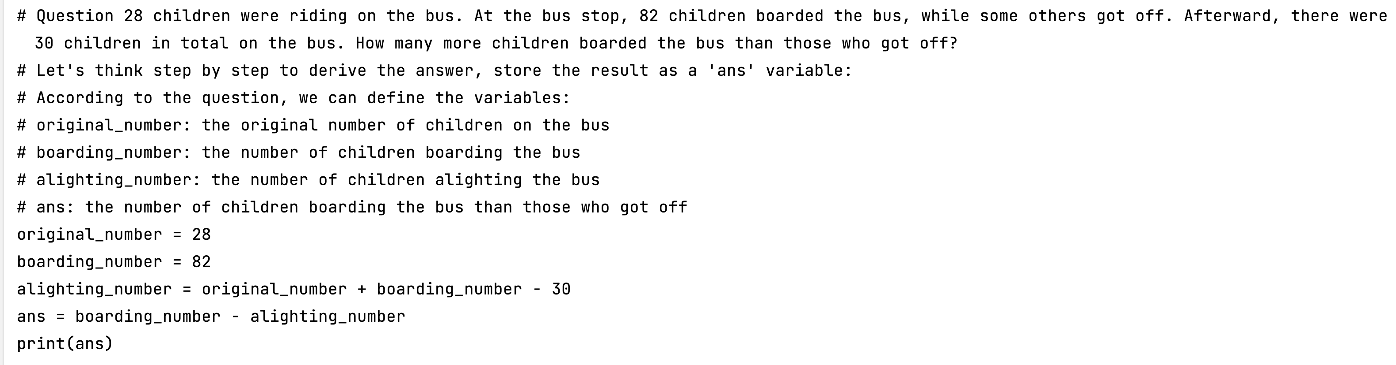
错误case 的解决1
Text-davinci-002推理的过程没有问题

Slide 6
错误case 的解决1
Mary is baking a cake. The recipe calls for 12 cups of sugar and 14 cups of flour. She already put in 10 cups of sugar. How many more cups of flour than cups of sugar does she need to add now?
换一个题不行
Text-davinci-002推理的过程没有问题

Slide 7
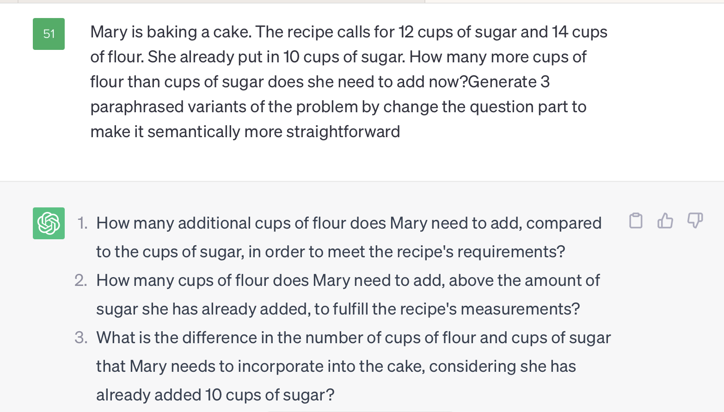
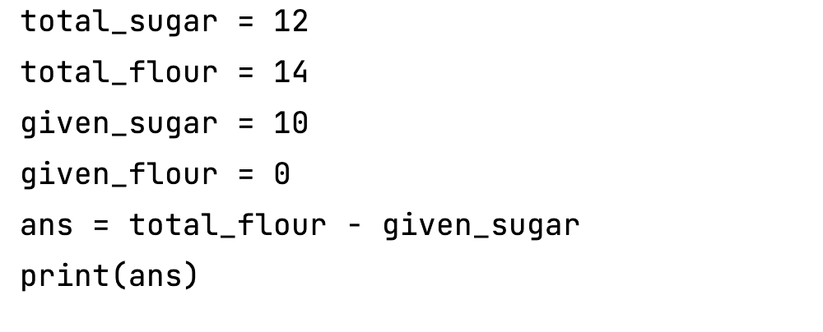
错误case 的解决1
换一个题不行

Slide 8
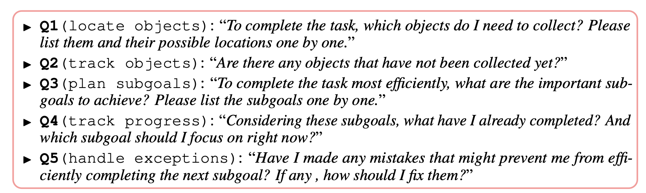
错误case 的解决2
SWIFTSAGE: A Generative Agent with Fast and Slow Thinking for Complex Interactive Tasks

Slide 9
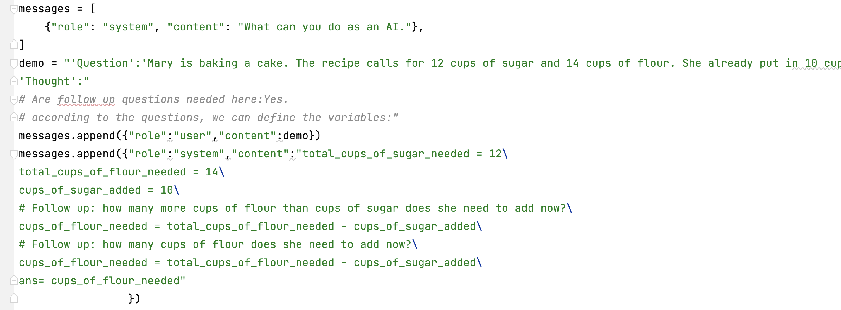
错误case 的解决2

Slide 10
错误case 的解决2
"Have I made any mistakes in any equation? If any , how should I fix them? please output complete answer"

Slide 11
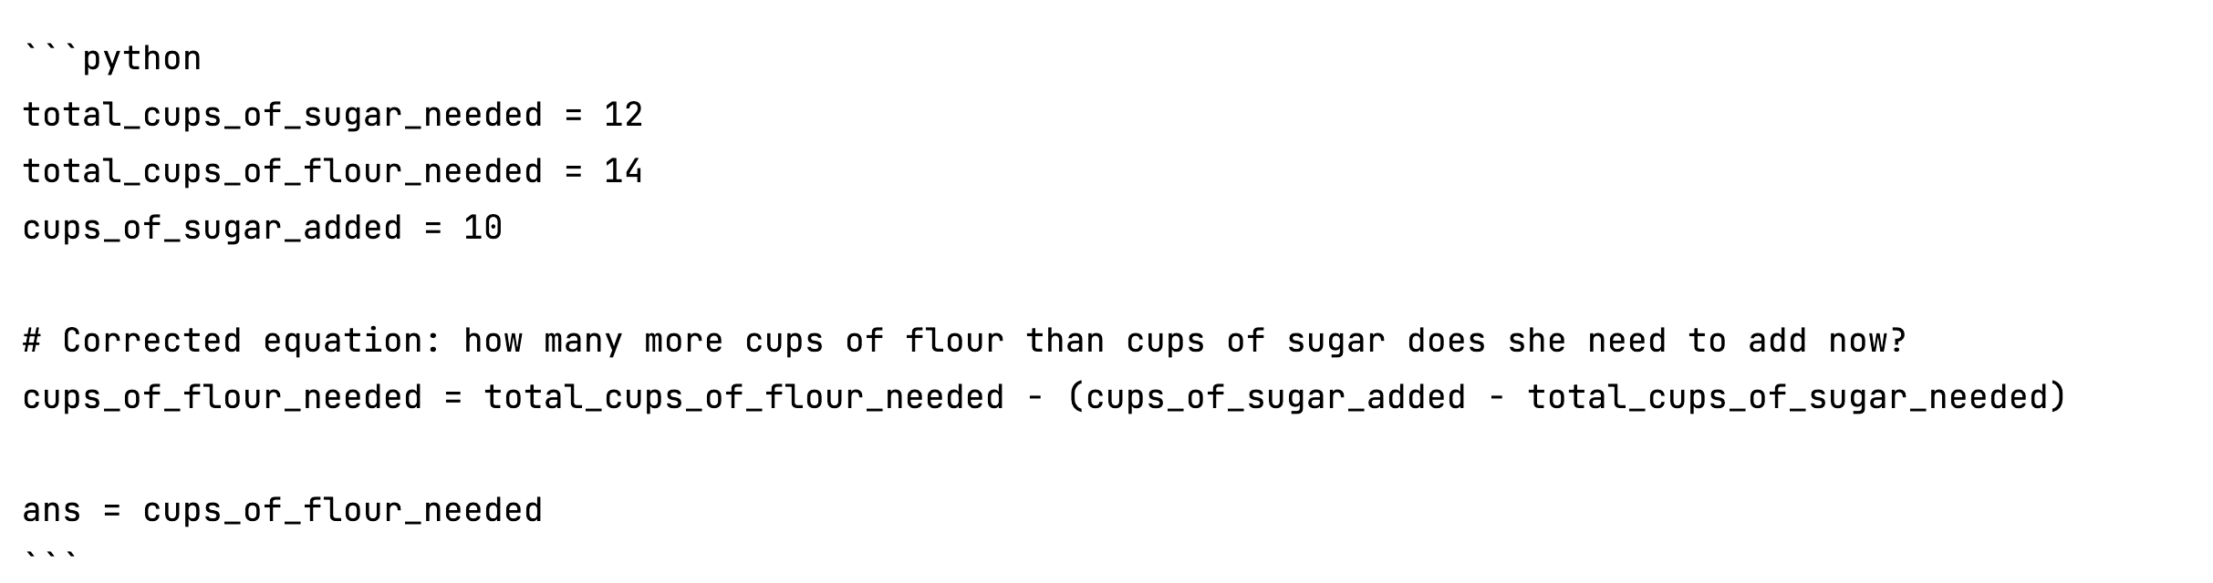
错误case 的解决2

Slide 12
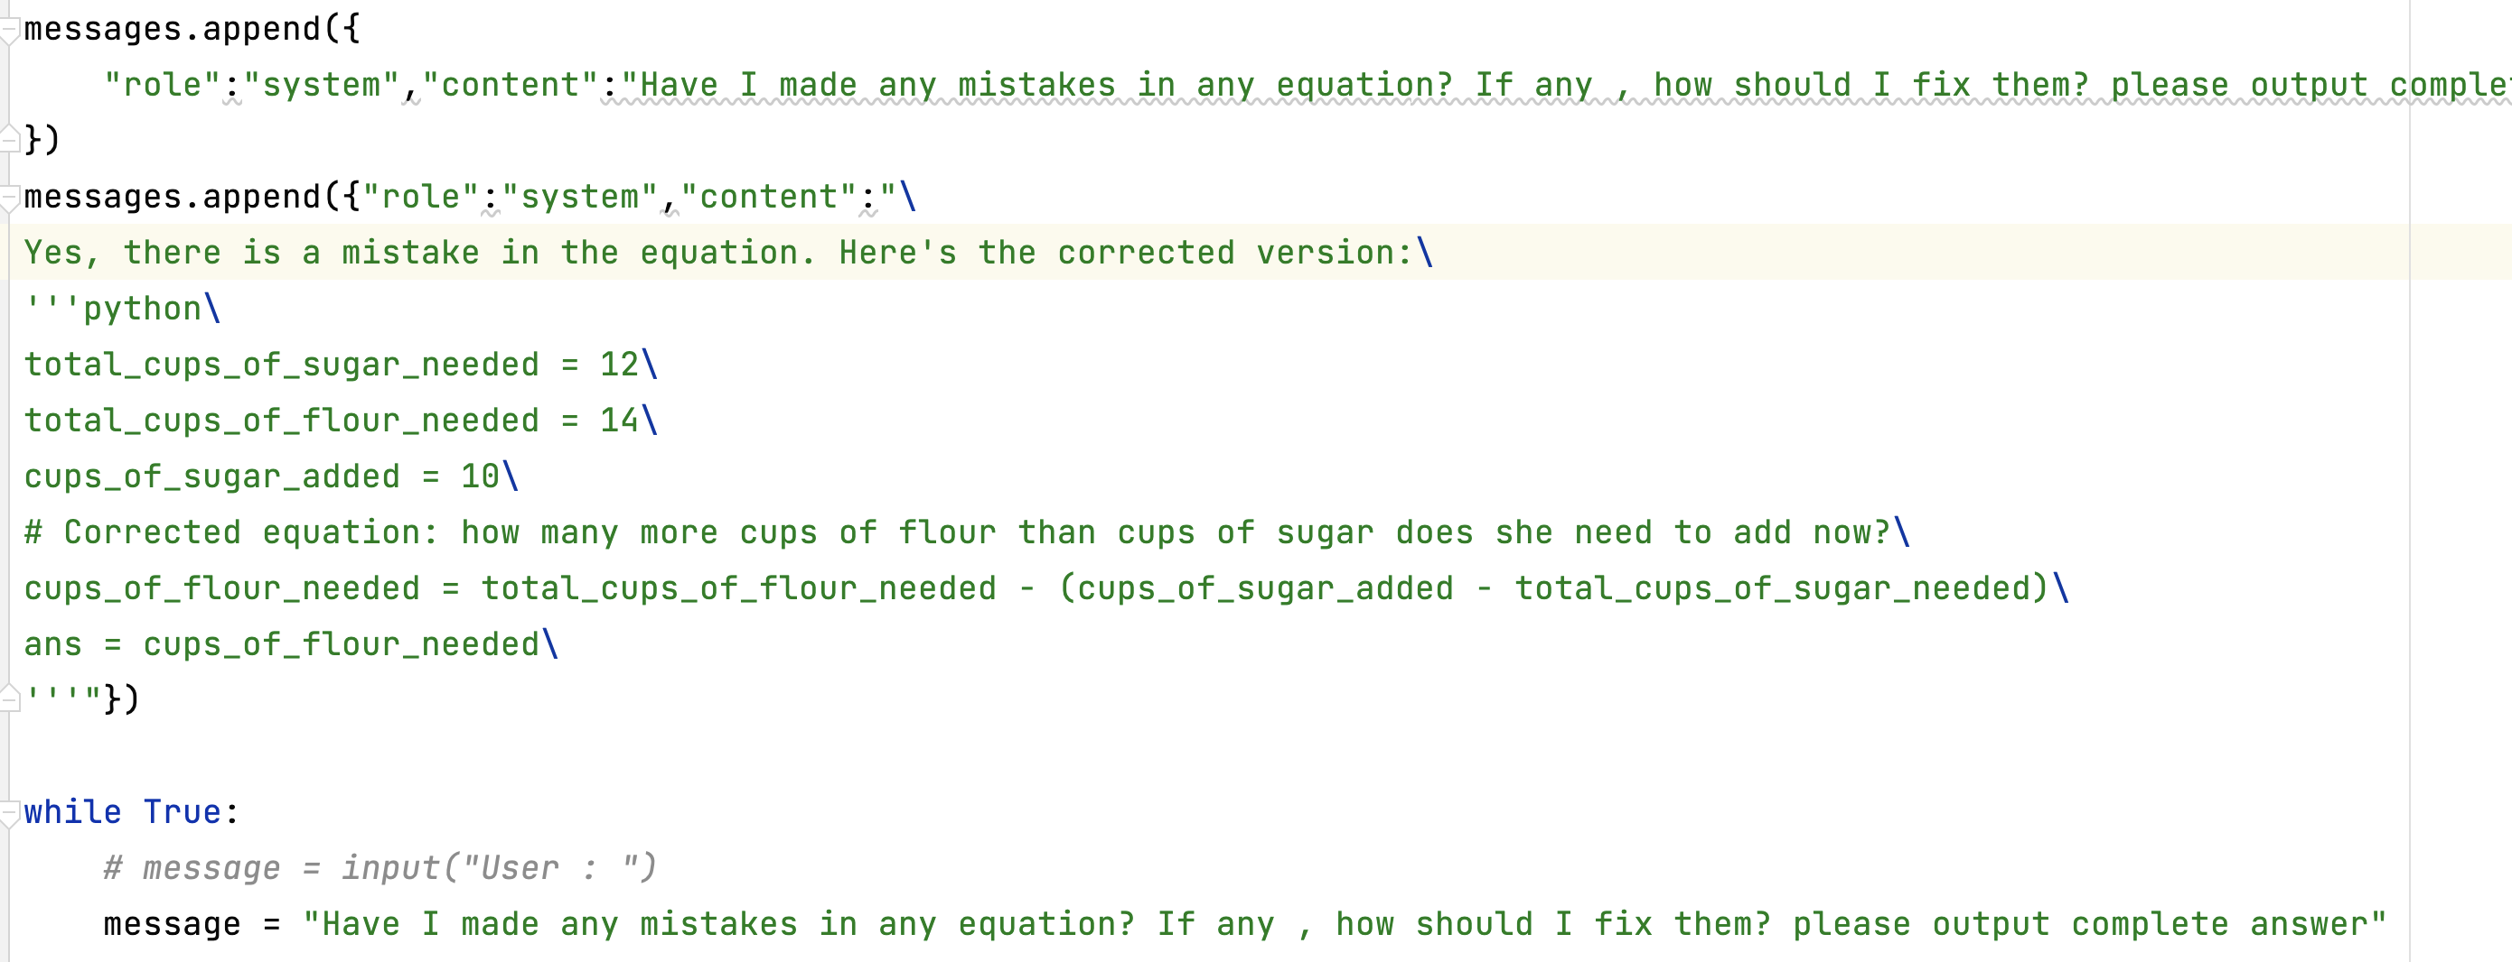
错误case 的解决2

Slide 13
错误case 的解决2
基于修正的方式不能解决这个问题，还有可能带偏错误的解答

Slide 14
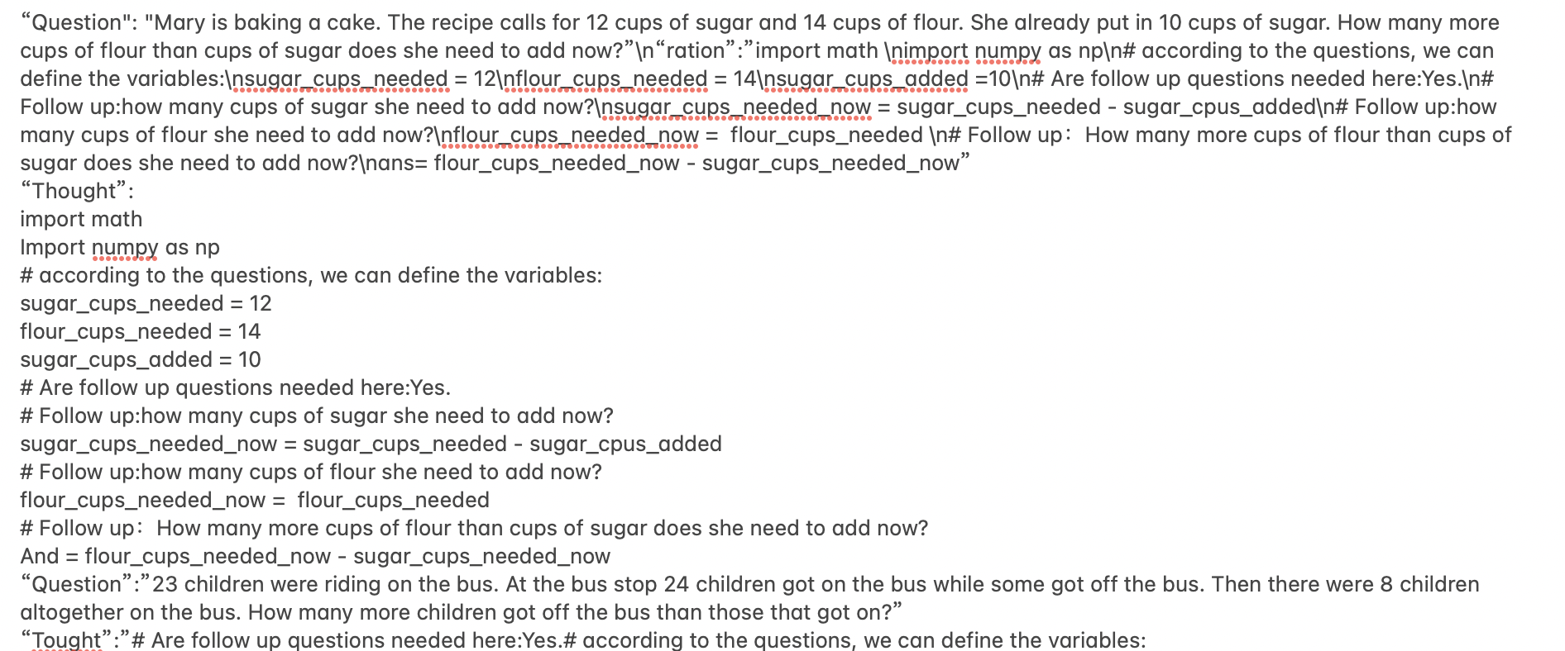
错误case 的解决3

Slide 15
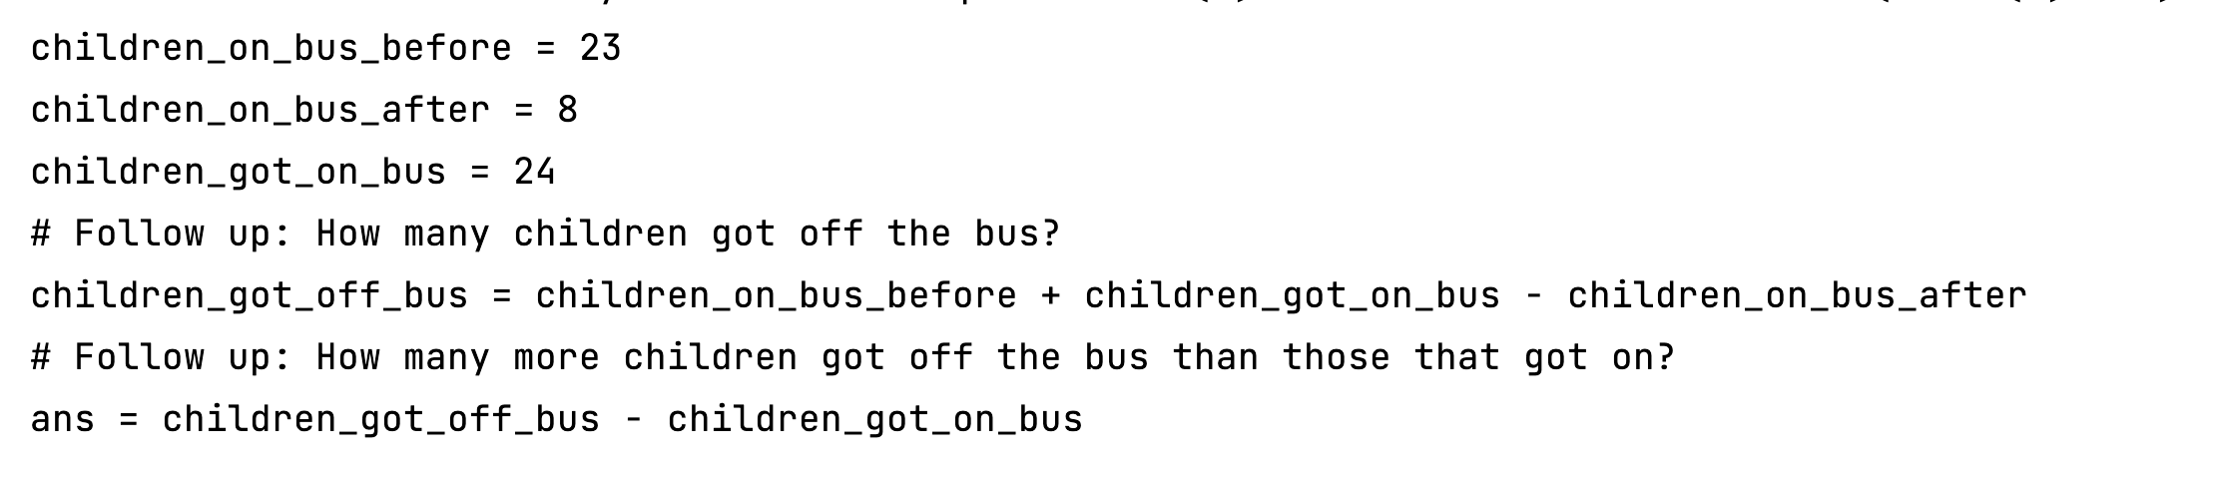
错误case 的解决3

Slide 16
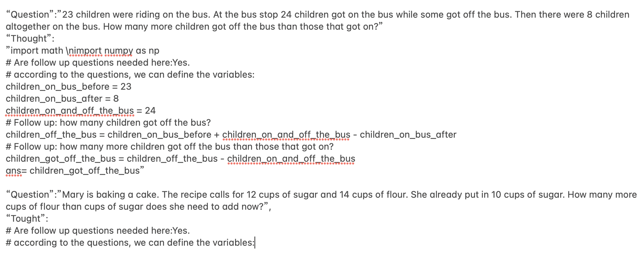
错误case 的解决3
Measuring and Narrowing the Compositionality Gap in Language Models

Slide 17
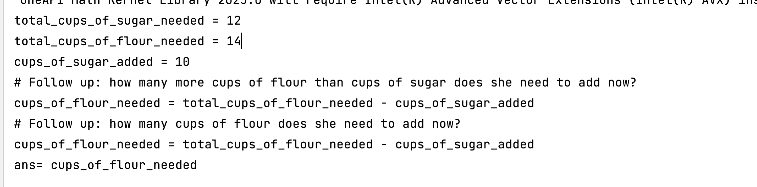
错误case 的解决3
基于text-davinci-002 解答错误

Slide 18
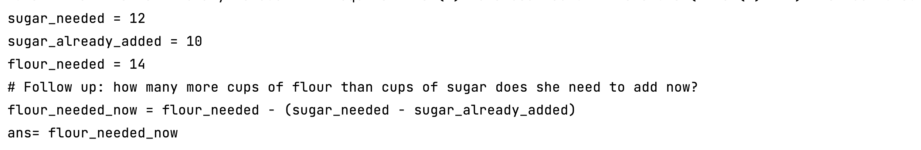
错误case 的解决3
基于text-davinci-003 解答正确

Slide 19
基于composition+sc的方法
method | Errors number
Auto-pot | 18
One-shot pot+composistion | 6
One-shot pot+composistion+sc | 1
import math
Import numpy as np
# according to the questions, we can define the variables:
sugar_cups_needed = 12
flour_cups_needed = 14
sugar_cups_added = 10
# Are follow up questions needed here:Yes.
# Follow up:how many cups of sugar she need to add now?
sugar_cups_needed_now = sugar_cups_needed - sugar_cpus_added
# Follow up:how many cups of flour she need to add now?
flour_cups_needed_now = flour_cups_needed
# Follow up：How many more cups of flour than cups of sugar does she need to add now?
And = flour_cups_needed_now - sugar_cups_needed_now
Measuring and Narrowing the Compositionality Gap in Language Models

Slide 20
基于composition+sc的方法
method | Errors number
Auto-pot | 18
One-shot pot+composistion | 6
One-shot pot+composistion+sc | 1
{"Question": "The ring toss game at the carnival made the same amount of money each day. In total in 30 days they earned 420 dollars. Together with game they earned 22 dollars. How much did ring toss game make per day?",
"Program": "total_money_earned = 420\nmoney_earned_from_game = 22\ndays = 30\n# Follow up: How much did ring toss game make per day?\nring_toss_game_earnings = total_money_earned - money_earned_from_game\nring_toss_game_daily_earnings = ring_toss_game_earnings / days\n\nans = ring_toss_game_daily_earnings",
"Ans": 13.266666666666667}
使用cs过程中发现，多次尝试的结果也不同；可能需要采样更多的次数

Slide 21
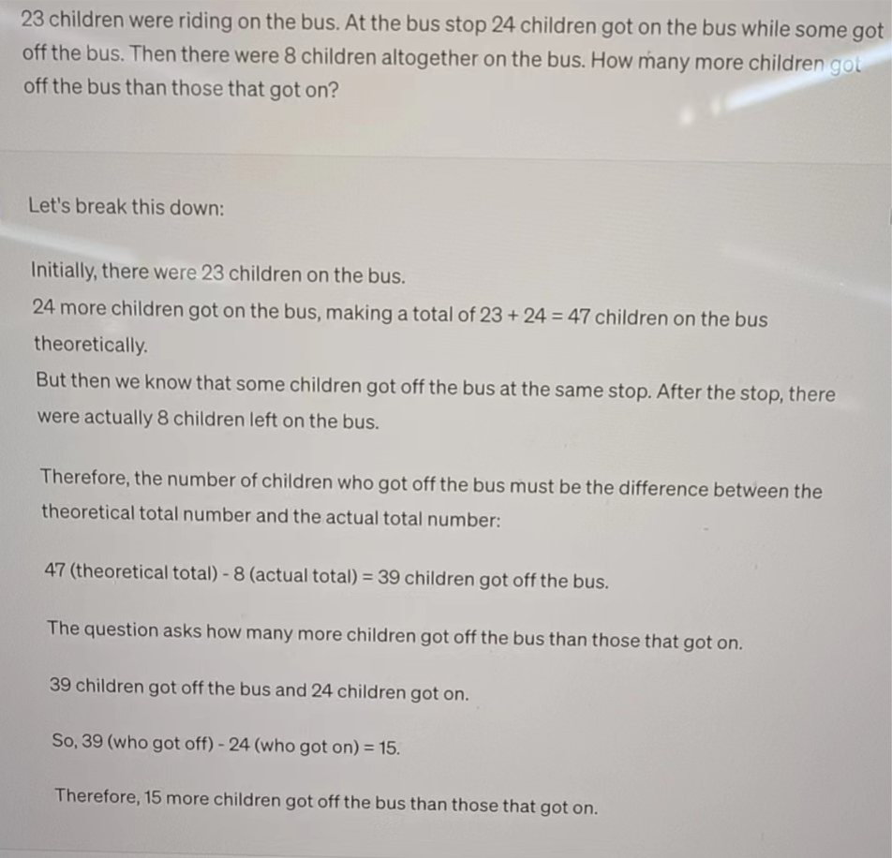
gpt4

Slide 22
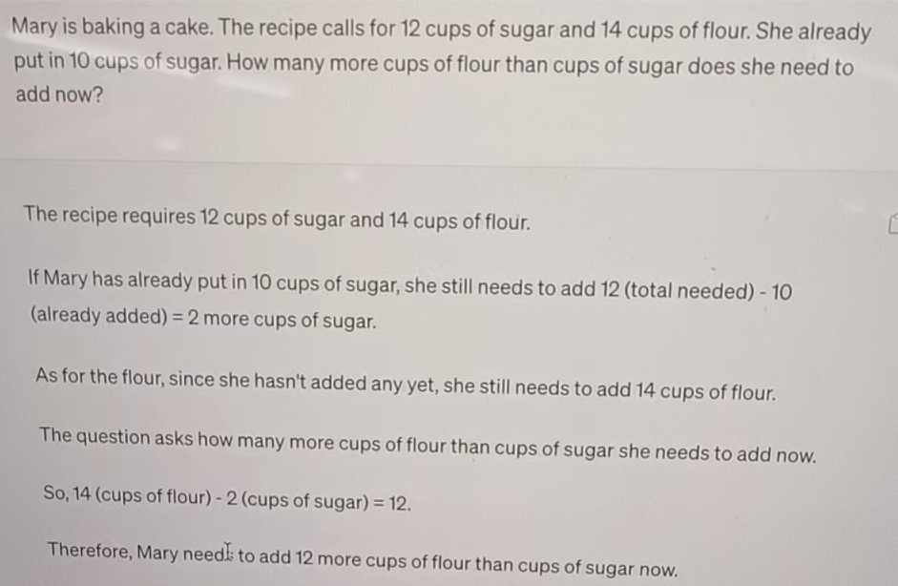
gpt4

Slide 23
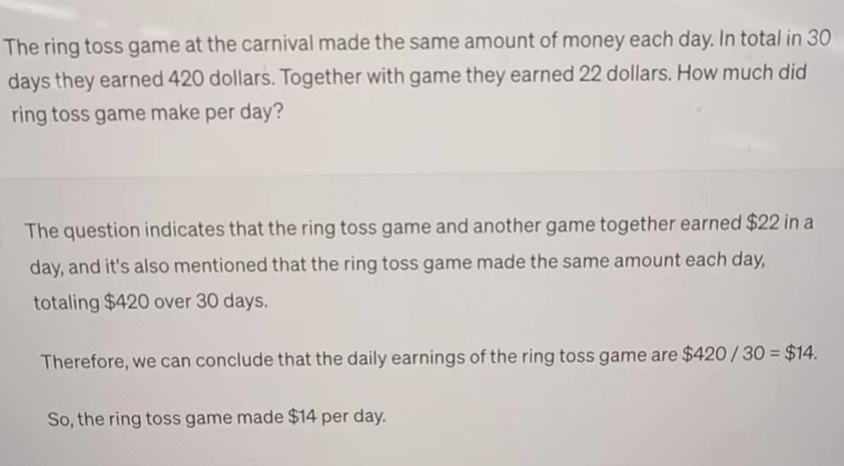
gpt4

Slide 24
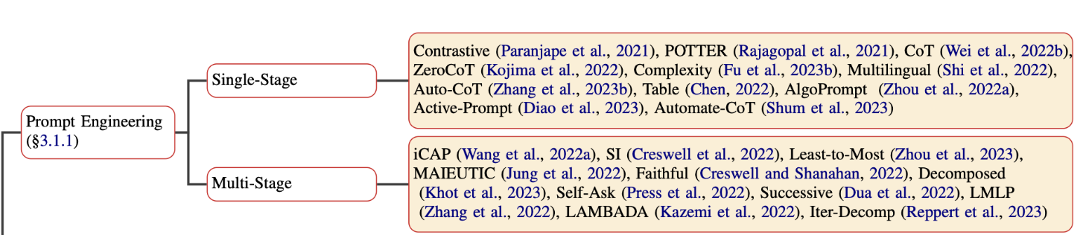
Prompt engineering
Reasoning with language Model Prompting:A Survey

Slide 25
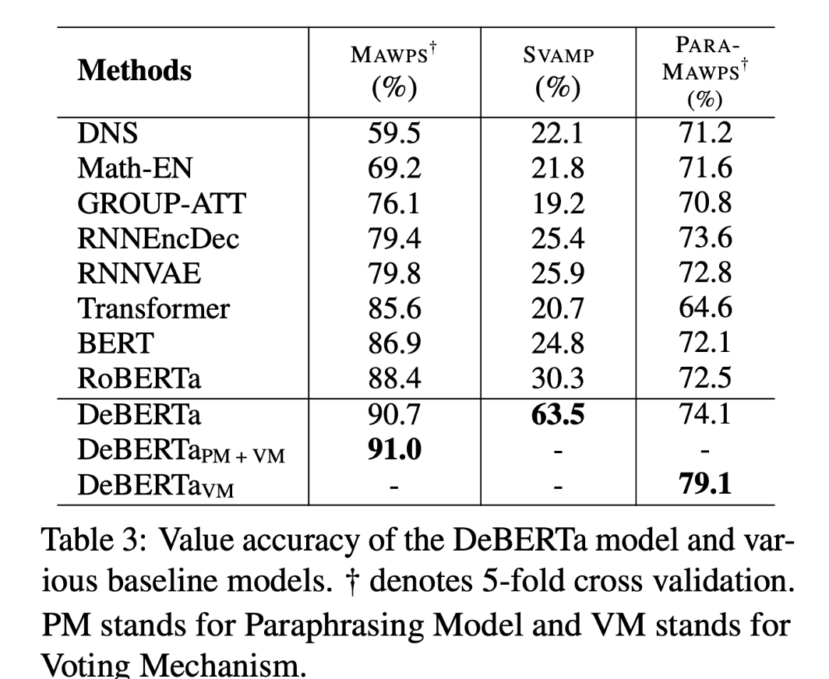
Knowledge distillation

Slide 26
实验分析
如何在无标注的情况下判断答案的正确和错误：
1.纠错的prompt能不能用在全量数据上：91%
2.能否通过众数投票确定最终答案的正确来实现整个过程的无监督学习
3.能否证明它在训练集上的错误案例也有效

Slide 27
THANKS

